Slide 1
Chapter 6
Regression

Slide 2
Simple Linear Regression Model
We use least squares estimators of β₀ and β₁ and called them

Slide 3
What is the Dow Jones Industrial Average (DJIA)?
A stock market index
Comprised of the stock of 30 companies
A scaled measure of the average price of the stocks
A measure of how stock market companies are doing in general
It is not a measure of employment

Slide 4
DJIA Companies
3M
Alcoa
American Express
AT&T
Bank of America
Boeing
Caterpillar
Chevron
Cisco
Coca-Cola
DuPont
Exxon Mobil
General Electric
Hewlett-Packard
Home Depot
Intel
IBM
Johnson & Johnson
JP Morgan Chase
Kraft Foods
McDonald’s
Merck and Co.
Microsoft
Pfizer
Procter and Gamble
Travelers
United Technologies
Verizon
Wal-Mart
Walt Disney

Slide 5
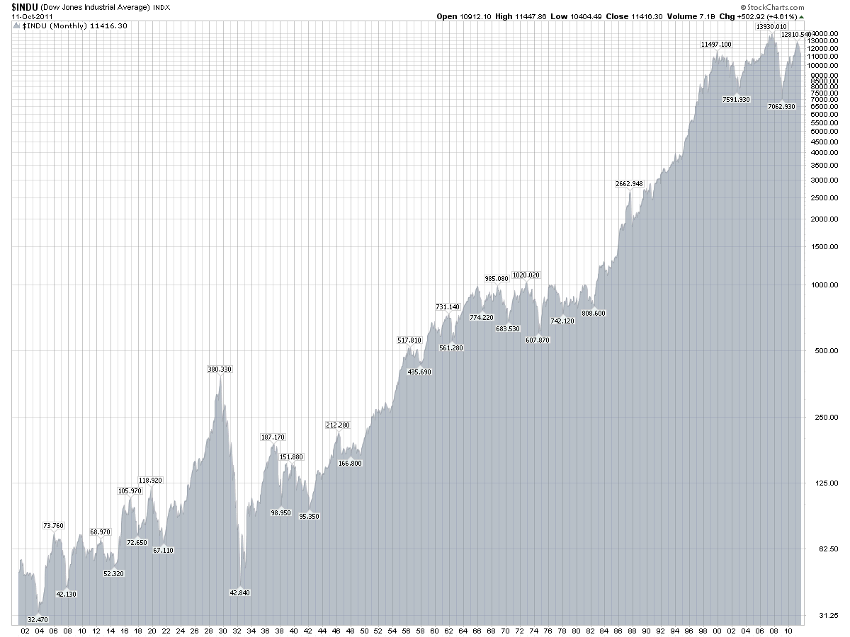
DJIA Over Time

Slide 6
DJIA vs. Sunspots
DJIA | Sunspot
Peaks | Peaks
1937.17 | 1938.25
1946.33 | 1948.67
1956.25 | 1958.42
1966 | 1969.25
1976.5 | 1980.83
1987.58 | 1990.5
1999.92 | 2001.17
http://wattsupwiththat.files.wordpress.com/2008/11/modis_2007_technological-forecasting-and-social-change.pdf

Slide 7
Beware Of Headlines
Cell phone usage increases risk of brain cancer
Caffeine usage linked to miscarriages
The rich got richer and the poor got poorer
Caffeine improves gym performance
If you go outside in the cold without a hat you’ll catch pneumonia
Ninety-one percent (91%) of lung cancer patients have eaten carrots at least once a week.
Look at the data. Look at the p-value.

Slide 8
Mock Exam 2 vs Exam 2
Mock Exam 2 | Exam 2
73 | 84
84 | 76
77 | 76
69 | 56
74 | 84
80 | 80
82 | 80
65 | 68
75 | 88
81 | 80
68 | 64
76 | 100
36 | 52
76 | 84
72 | 84
82 | 104
76 | 96
100 | 84
59 | 52
88 | 92
71 | 48
68 | 64
35 | 60
80 | 60
46 | 68
103 | 76
76 | 80
64 | 60
35 | 48
n = 29

Slide 9
Model and Hypothesis Tests
General Simple Linear Regression Model: Y = β₀ + β₁X
X: Mock Exam 2 Score Y: Exam 2 Score
Hypothesis Tests: Excel Output:
H₀: β₀ = 0 H₀: β₁ = 0
H₁: β₀ ≠ 0 H₁: β₁ ≠ 0
p-value = .0036 p-value = .0005
Reject H₀ for both.
Both β₀ and β₁ are statistically significant and should be included in the model.
Use
Final Model: Y = 33.428 + .569X
Additionally, P(11.909 < β₀ < 54.948) = .95 and P(.275 < β₁ < .863) = .95
 | Coefficient | Standard Error | t Stat | P-value | Lower 95% | Upper 95%
Intercept | 33.428 | 10.488 | 3.187 | 0.0036 | 11.909 | 54.948
MockExam2 | 0.569 | 0.143 | 3.974 | 0.0005 | 0.275 | 0.863

Slide 10
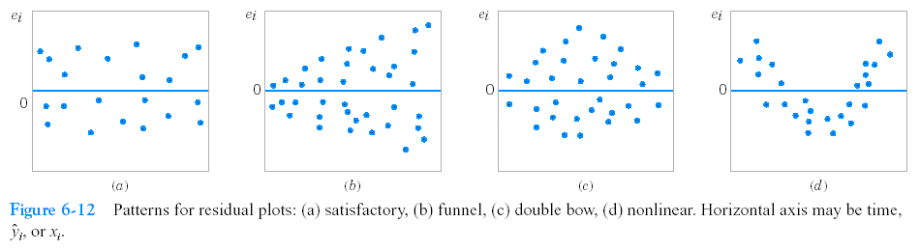
Residual Analysis
Compute and plot the residuals, e_{i}
Residual: Response you actually got – response that your model predicts
Residual plot should appear to be a random scattering above and below zero (a). This random scattering about zero indicates that the residuals, the errors, are normally distributed, which is what we want.
Desired from model
(b) , (c ) and (d) indicated non-constant variance

Slide 11
Residual Analysis
Final Model: Y = 33.428 + .569X
Mock Pred
Exam2 Exam2 Exam2 Res
73 | 84 | 74.965 | 9.035
84 | 76 | 81.224 | -5.224
77 | 76 | 77.241 | -1.241
69 | 56 | 72.689 | -16.689
74 | 84 | 75.534 | 8.466
80 | 80 | 78.948 | 1.052
82 | 80 | 80.086 | -0.086
65 | 68 | 70.413 | -2.413
75 | 88 | 76.103 | 11.897
81 | 80 | 79.517 | 0.483
68 | 64 | 72.12 | -8.12
76 | 100 | 76.672 | 23.328
36 | 52 | 53.912 | -1.912
76 | 84 | 76.672 | 7.328
72 | 84 | 74.396 | 9.604
82 | 104 | 80.086 | 23.914
76 | 96 | 76.672 | 19.328
100 | 84 | 90.328 | -6.328
59 | 52 | 66.999 | -14.999
88 | 92 | 83.5 | 8.5
71 | 48 | 73.827 | -25.827
68 | 64 | 72.12 | -8.12
35 | 60 | 53.343 | 6.657
80 | 60 | 78.948 | -18.948
46 | 68 | 59.602 | 8.398
103 | 76 | 92.035 | -16.035
76 | 80 | 76.672 | 3.328
64 | 60 | 69.844 | -9.844
35 | 48 | 53.343 | -5.343
71.41379 | 74.06897
16.56269 | 15.51481 |  | 0.006517
Sample mean of residuals = .006517
Residual
Observation
If this model is a ‘good’ one, the differences (called residuals) between the actual Exam2 score and the model-predicted Exam 2 scores will be normally distributed with a mean of 0. They will look very random, evenly-distributed above and below 0, and with a mean close to 0.

Slide 12
Section 6-3 Multiple Regression

Slide 13
Multiple Linear Regression
Used when you believe a variable is linearly dependent upon several other variables
Multiple Linear Regression Model:

Slide 14

Jet
Turbine
Data
Thrust (y) | Primary speed of rotation (x1) | Secondary speed of rotation (x2) | Fuel flow rate (x3) | Pressure (x4) | Exhaust temp (x5) | Ambient temp (x6)
4540 | 2140 | 20640 | 30250 | 205 | 1732 | 99
4315 | 2016 | 20280 | 30010 | 195 | 1697 | 100
4095 | 1905 | 19860 | 29780 | 184 | 1662 | 97
3650 | 1675 | 18980 | 29330 | 164 | 1598 | 97
3200 | 1474 | 18100 | 28960 | 144 | 1541 | 97
4833 | 2239 | 20740 | 30083 | 216 | 1709 | 87
4617 | 2120 | 20305 | 29831 | 206 | 1669 | 87
4340 | 1990 | 19961 | 29604 | 196 | 1640 | 87
3820 | 1702 | 18916 | 29088 | 171 | 1572 | 85
3368 | 1487 | 18012 | 28675 | 149 | 1522 | 85
4445 | 2107 | 20520 | 30120 | 195 | 1740 | 101
4188 | 1973 | 20130 | 29920 | 190 | 1711 | 100
3981 | 1864 | 19780 | 29720 | 180 | 1682 | 100
3622 | 1674 | 19020 | 29370 | 161 | 1630 | 100
3125 | 1440 | 18030 | 28940 | 139 | 1572 | 101
4560 | 2165 | 20680 | 30160 | 208 | 1704 | 98
4340 | 2048 | 20340 | 29960 | 199 | 1679 | 96
4115 | 1916 | 19860 | 29710 | 187 | 1642 | 94
http://www.garrisonwu.com/images/Events/Thumbs/F15Afterburn.jpg

Slide 15
NMOS Width (x1) | NMOS Length (x2) | PMOS Width (x3) | PMOS Length (x4) | Transient point (y)
3 | 3 | 3 | 3 | 0.787
8 | 30 | 8 | 8 | 0.293
3 | 6 | 6 | 6 | 1.71
4 | 4 | 4 | 12 | 0.203
8 | 7 | 6 | 5 | 0.806
10 | 20 | 5 | 5 | 4.713
8 | 6 | 3 | 3 | 0.607
6 | 24 | 4 | 4 | 9.107
4 | 10 | 12 | 4 | 9.21
16 | 12 | 8 | 4 | 1.365
3 | 10 | 8 | 8 | 4.554
8 | 3 | 3 | 3 | 0.293
3 | 6 | 3 | 3 | 2.252
3 | 8 | 8 | 3 | 9.167
4 | 8 | 4 | 8 | 0.694
5 | 2 | 2 | 2 | 0.379
2 | 2 | 2 | 3 | 0.485
10 | 15 | 3 | 3 | 3.345
15 | 6 | 2 | 3 | 0.208
15 | 6 | 2 | 3 | 0.201
10 | 4 | 3 | 3 | 0.329
3 | 8 | 2 | 2 | 4.966
Electronic
Inverter
Data
NMOS: Negative Channel Metal Oxide Semi-conductor
PMOS: Positive Channel Metal Oxide Semi-conductor

Slide 16

Wine
Data
Clarity | Aroma | Body | Flavor | Oakiness | Quality | Region
1 | 3.3 | 2.8 | 3.1 | 4.1 | 9.8 | 1
1 | 4.4 | 4.9 | 3.5 | 3.9 | 12.6 | 1
1 | 3.9 | 5.3 | 4.8 | 4.7 | 11.9 | 1
1 | 3.9 | 2.6 | 3.1 | 3.6 | 11.1 | 1
1 | 5.6 | 5.1 | 5.5 | 5.1 | 13.3 | 1
1 | 4.6 | 4.7 | 5 | 4.1 | 12.8 | 1
1 | 4.8 | 4.8 | 4.8 | 3.3 | 12.8 | 1
1 | 5.3 | 4.5 | 4.3 | 5.2 | 12 | 1
1 | 4.3 | 4.3 | 3.9 | 2.9 | 13.6 | 3
1 | 4.3 | 3.9 | 4.7 | 3.9 | 13.9 | 1
1 | 5.1 | 4.3 | 4.5 | 3.6 | 14.4 | 3
0.5 | 3.3 | 5.4 | 4.3 | 3.6 | 12.3 | 2
0.8 | 5.9 | 5.7 | 7 | 4.1 | 16.1 | 3
0.7 | 7.7 | 6.6 | 6.7 | 3.7 | 16.1 | 3
1 | 7.1 | 4.4 | 5.8 | 4.1 | 15.5 | 3
0.9 | 5.5 | 5.6 | 5.6 | 4.4 | 15.5 | 3
1 | 6.3 | 5.4 | 4.8 | 4.6 | 13.8 | 3
1 | 5 | 5.5 | 5.5 | 4.1 | 13.8 | 3
1 | 4.6 | 4.1 | 4.3 | 3.1 | 11.3 | 1

Slide 17
Multiple Linear Regression Model
We will again use least squares estimators of the β’s:
Regressor: the independent variables x₁ , x₂ , …, x_{i}
β₀ is a constant
β_{i} are coefficients on the regressors

Slide 18
Multiple Regression Analysis
Two parts:
ANOVA Hypothesis Test for Significance of Regression: is there at least one independent variable that is significant?
Hypothesis Tests on Constant and Significance of Individual Regressors: which independent variables are significant?
…
* We also do a hypothesis test on β₀ but it is not a regressor coefficient

Slide 19
Refining the Model
Refine the model by eliminating those regressors for which you could not reject H
Compute and plot the residuals, e_{i}
Residual: Response you actually got – response that your model predicts
Residual plot should appear to be a random scattering above and below zero (a). This random scattering about zero indicates that the residuals, the errors, are normally distributed, which is what we want.
Desired from model
(b) , (c ) and (d) indicated non-constant variance

Slide 20
How to do Multiple Regression Analysis Using Excel

Slide 21
Data
Observation | Pull | Wire | Die
Number | Strength (Y) | Length (X1) | Height (X2)
1 | 9.95 | 2 | 50
2 | 24.45 | 8 | 110
3 | 31.75 | 11 | 120
4 | 35 | 10 | 550
5 | 25.02 | 8 | 295
6 | 16.86 | 4 | 200
7 | 14.38 | 2 | 375
8 | 9.6 | 2 | 52
9 | 24.35 | 9 | 100
10 | 27.5 | 8 | 300
11 | 17.08 | 4 | 412
12 | 37 | 11 | 400
13 | 41.95 | 12 | 500
14 | 11.66 | 2 | 360
15 | 21.65 | 4 | 205
16 | 17.89 | 4 | 400
17 | 69 | 20 | 600
18 | 10.3 | 1 | 585
19 | 34.93 | 10 | 540
20 | 46.59 | 15 | 250
21 | 44.88 | 15 | 290
22 | 54.12 | 16 | 510
23 | 56.63 | 17 | 590
24 | 22.13 | 6 | 100
25 | 21.15 | 5 | 400
Put data into Excel sheet.
Click on Data tab
Click on Data Analysis tab (you may need to get the Add-In for this part)
Select Regression
Highlight Y and X per dialogue box prompt
Select output location per dialogue box
Determine which regressors are significant
Refine model
Compute and plot residuals

Slide 22
Output
 | Coefficients | Standard Error | t Stat | P-value | Lower 95% | Upper 95%
Intercept | 2.264 | 1.060 | 2.136 | 0.044 | 0.065 | 4.462
X Variable 1 | 2.744 | 0.094 | 29.343 | 0.000 | 2.550 | 2.938
X Variable 2 | 0.013 | 0.003 | 4.477 | 0.000 | 0.007 | 0.018
Use α = .05
Refined (final) model: Y = 2.264 + 2.744x₁ + .013x₂
Values in Excel cells were rounded to three decimal places

Slide 23
Residual Computations and Plot
Observation | Pull | Wire | Die | Model Predicted
Number | Strength (Y) | Length (X1) | Height (X2) | Y=2.264+2.744x1+.013x2 | Residual
1 | 9.95 | 2 | 50 | 8.402 | 1.548
2 | 24.45 | 8 | 110 | 25.646 | -1.196
3 | 31.75 | 11 | 120 | 34.008 | -2.258
4 | 35 | 10 | 550 | 36.854 | -1.854
5 | 25.02 | 8 | 295 | 28.051 | -3.031
6 | 16.86 | 4 | 200 | 15.84 | 1.02
7 | 14.38 | 2 | 375 | 12.627 | 1.753
8 | 9.6 | 2 | 52 | 8.428 | 1.172
9 | 24.35 | 9 | 100 | 28.26 | -3.91
10 | 27.5 | 8 | 300 | 28.116 | -0.616
11 | 17.08 | 4 | 412 | 18.596 | -1.516
12 | 37 | 11 | 400 | 37.648 | -0.648
13 | 41.95 | 12 | 500 | 41.692 | 0.258
14 | 11.66 | 2 | 360 | 12.432 | -0.772
15 | 21.65 | 4 | 205 | 15.905 | 5.745
16 | 17.89 | 4 | 400 | 18.44 | -0.55
17 | 69 | 20 | 600 | 64.944 | 4.056
18 | 10.3 | 1 | 585 | 12.613 | -2.313
19 | 34.93 | 10 | 540 | 36.724 | -1.794
20 | 46.59 | 15 | 250 | 46.674 | -0.084
21 | 44.88 | 15 | 290 | 47.194 | -2.314
22 | 54.12 | 16 | 510 | 52.798 | 1.322
23 | 56.63 | 17 | 590 | 56.582 | 0.048
24 | 22.13 | 6 | 100 | 20.028 | 2.102
25 | 21.15 | 5 | 400 | 21.184 | -0.034
 |  |  |  | Sample Ave. of Res. = | -0.15464
Residual
Observation number
Residuals appear to be randomly scattered above and below 0 (normally distributed with mean of 0)
**Note that the sample average of the residuals is close to 0.

Slide 24
Example Problem and Questions
The % yield of a chemical process that produces fertilizer is thought to be modeled by % sodium, % potassium, and % nitrogen as a multiple linear regression. Data from 12 sample batches is shown below.
% Sodium | % Potassium | % Nitrogen | % Yield
13 | 5 | 11 | 62.9
15 | 3 | 11 | 76.1
13 | 4 | 13 | 87.5
15 | 8 | 13 | 102.3
14 | 9 | 12 | 76.2
14 | 6 | 12 | 77.5
14 | 3 | 12 | 76.8
14 | 1 | 12 | 77.4
14 | 4 | 12 | 78.7
15 | 6 | 13 | 102.3
14 | 6 | 12 | 76.2
14 | 7 | 12 | 77.5

Slide 25
The Excel output from a multiple linear regression analysis is shown as follows
ANOVA
 | df | SS | MS | F | Significance F
Regression | 3 | 1333.02875 | 444.3429 | 46.52322 | 2.07893E-05
Residual | 8 | 76.40793055 | 9.550991
Total | 11 | 1409.436681
 | Coefficients | Standard Error | t Stat | P-value | Lower 95% | Upper 95%
Intercept | -187.6013361 | 24.29922389 | -7.720466 | 5.64E-05 | -243.6354469 | -131.5672253
% Sodium (x1) | 7.642408153 | 1.429301163 | 5.346954 | 0.000688 | 4.34643376 | 10.93838255
% Potassium (x2) | -0.124449849 | 0.42804193 | -0.290742 | 0.778643 | -1.11151631 | 0.862616611
% Nitrogen (x3) | 13.37158308 | 1.470817276 | 9.091261 | 1.72E-05 | 9.979872357 | 16.7632938

Slide 26
Know how to do these for Final Exam.
Show the ANOVA null and alternative hypotheses for this problem. What is your conclusion?
Show the null and alternative hypotheses for the constant and each coefficient in the model. What are your conclusions?
What is the final model that results?
Compute the residuals.
What is the desired mean of the residuals?
Plot the residuals.
Do the residuals appear to be normally distributed?
What is the 95% confidence interval on β₃ ?

